Slide 1
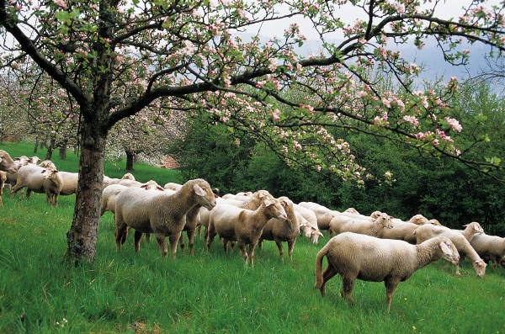
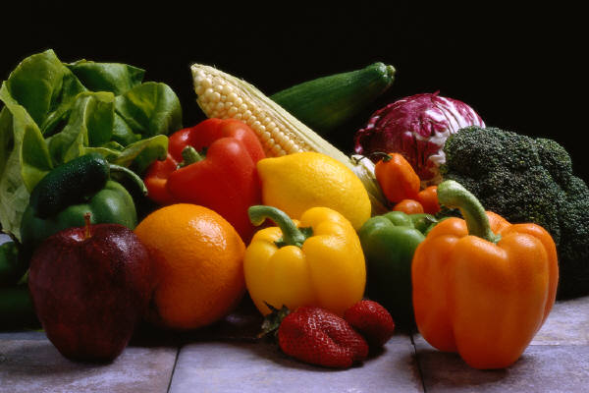
We are what we eat
Consumer education in sustainable agriculture and organic foods

Slide 2
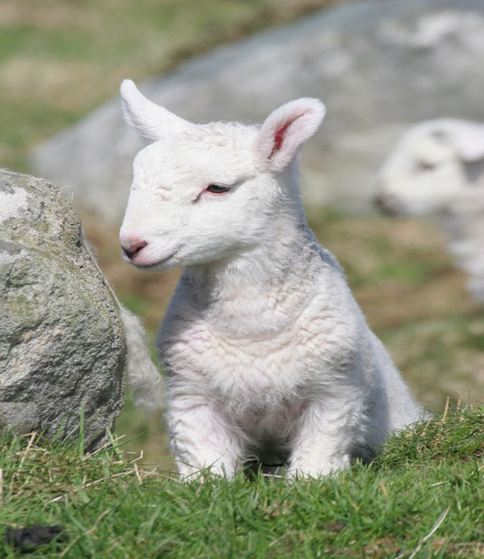
Global warming has generated a growing awareness of how each of us contribute to our environment by how we live our lives and the choices that we make.
Many consumers are re-thinking how they access food and the environmental impact of food production and distribution.
Simultaneously, consumers are thinking about food production methods and how these methods may affect our health.
Notes:
Text is a bit long but I would animate this so that only one text box opens at a time to reduce mental overload – may shorten the message to fewer words…

Slide 3
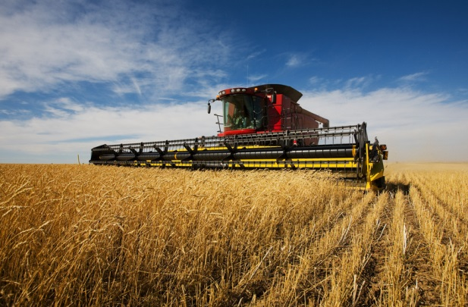
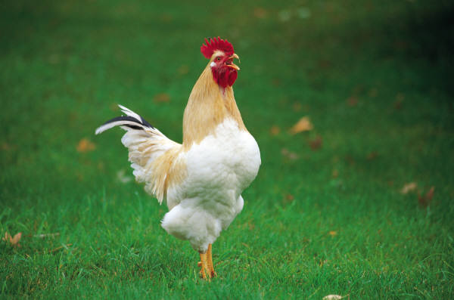
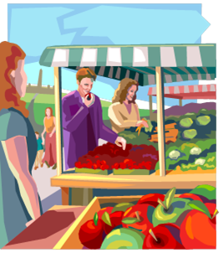
But there are still many who haven’t thought about food production and how it effects what they eat.
Organic farmers are realizing that it’s not enough to “just” produce high quality food using organic and humane methods.
We also need to educate the public at large about how food is grown and how that food production effects their health and the world in which we all live.

Slide 4
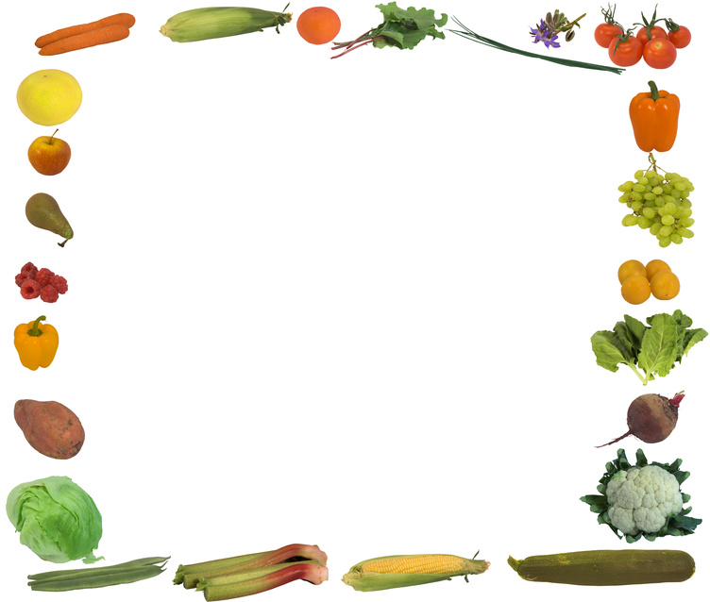
Consumer Education Audience – two main groups
Some knowledge
Individuals who are interested in contributing to improving our environment through their consumer choices
Locally and globally
Individuals who are curious about organic foods and humane animal management
Uninformed but curious
Individuals who are unaware of the difference between organic and non-organic foods
Individuals who are unaware of the environmental impact of commercial farming

Slide 5
More Audience Characteristics
Consumers are unsure how organic foods differ from more conventionally produced food (Mayo Clinic, 2012)
90% of American consumers were either considering or buying organic products (NEON, 2014)
Those considering the purchase of organic foods are most likely to be younger (under 40), well educated (high school or above), and more affluent (Context Marketing, 2009)
However, if 90% of consumers are considering organic foods, this is clearly a larger audience
Context Marketing. (2009, October). Beyond organic: How evolving consumer concerns influence food purchases . Retrieved from Agricultural Marketing: www.agmrc.org/markets_industries/food/organic-food-trends
Mayo Clinic. (2012, September 7). Organic foods: Are they safer? More nutritious? Retrieved from Mayo Clinic: http://www.mayoclinic.org/organic-food/ART-20043880
NEON. (2014, February 4). Home Page. Retrieved from Northeast Organic Network: www.neon.cornell.edu

Slide 6
To reach these consumers..
Educational environment must include these standards:
Literacy- high school level
Age range -18-65 years
Technology – simple, engaging, and user friendly

Slide 7
Educational Environment
Consumer education in sustainable agriculture, organic foods, and community supported agriculture
Introduction to It’s A Natural Farm and it’s role in community supported agricultural
It’s A Natural Farm Webpage

Slide 8
The Educational Environment
Sustainable Agriculture
Natural and humane production methods - No chemicals and free range
Responsible land management
Minimize “carbon footprint”
Plant diversification
Inform consumers not
just convert those to our perspective
Environment must be without ”hype”, low key, and leave the decisions to our consumers
Information balanced and objective

Slide 9
We seek to educate not just advertise
Provide information about organic versus non-organic
From quality sources
Referrals to articles and websites that offer good information for good choices
Provide information about It’s A Natural Farm
Who we are
Why we do this
Our farming practices
What we can offer

Slide 10
Outcomes
General Education
Build consumer awareness
Individual producer
Offer It’s a Natural Farm as a good consumer choice
Everyone wins!
“win/win” – healthier consumers, better environment, and we stay in business!

Slide 11
How do we know if and what they’ve learned?
A survey of “webpage visitors” could be conducted to determine if and what they have learned
“Tell us what you think” 4-5 question survey with open ended comment section
Feedback through emails and phone calls (contact information on webpage)

